Slide 1

ENGINEERING EXPLORATION PROJECT SEMINAR ON ATM MACHINE
CORE BRANCH:CSE (CSE-3) STUDENT NAME:G VIJAYA VENKATA SAI
ROLL NO: 1601-20-733-179
MENTOR NAME: J SHIVA SAI DESIGNATION: Asst Professor Dept of CSE

Slide 2

CONTENTS:
→Motivation
→Problem Statement
→Requirements
→Design
→Implementation
→Results & Discussion
→Conclusion
→Future scope
References

Slide 3
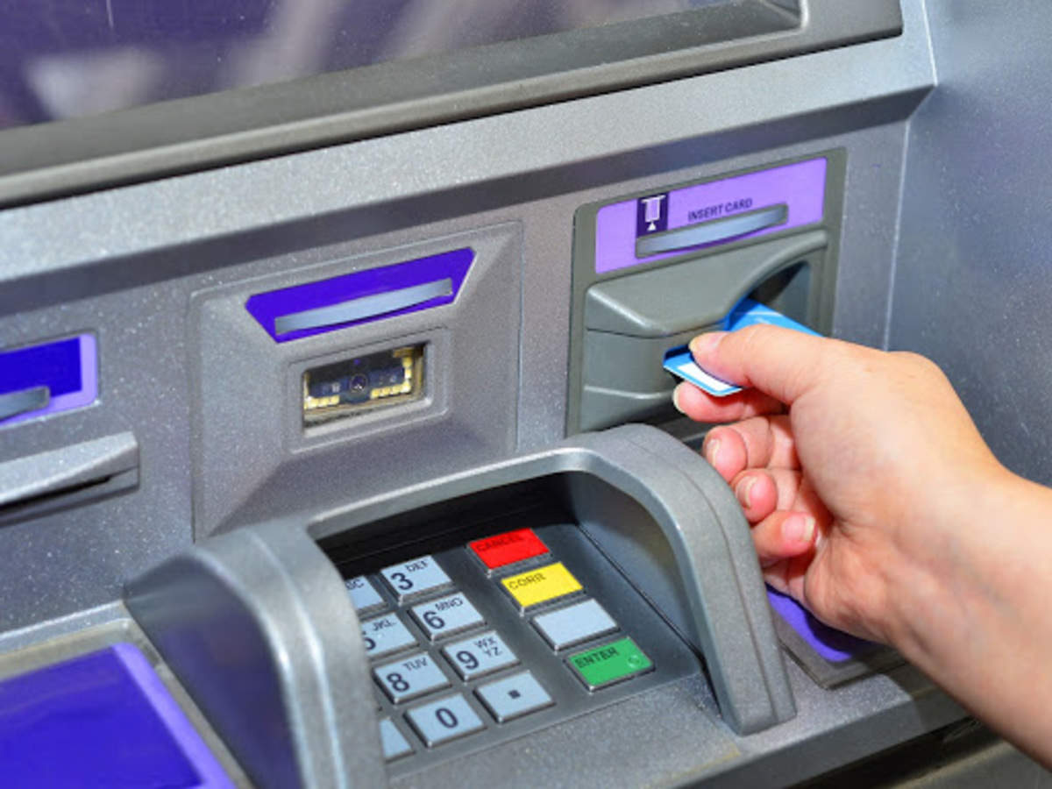
MOTIVATION
The ATM Machine has been taken as the problem statement because previously the banking system was very time consuming and tedious kind of work. We may face many problems while making the transactions in the bank . The banks have holidays but the ATMs don’t ,so when there is an urgency you could just go to an ATM and make your transaction done.

Slide 4
PROBLEM STATEMENT
Present system of banking needs more of both men and time so to make the bank transactions faster and efficient a system like ATM machine is required.
We are trying to make a program to do all the the transactions possible by an ATM.

Slide 5
REQUIREMENTS
Hardware
RAM: 16GB if possible or 8GB is enough
Storage: 256GB SSD for optimal performance
CPU: Intel i5/i7 core for good processor speed

Slide 6
REQUIREMENTS
Software
Operating system: Operating system can be of any basic Windows , Linux, MAC OS.
Compiler and Environment: GNU GCC compiler and CODEBLOCKS
environment.

Slide 7
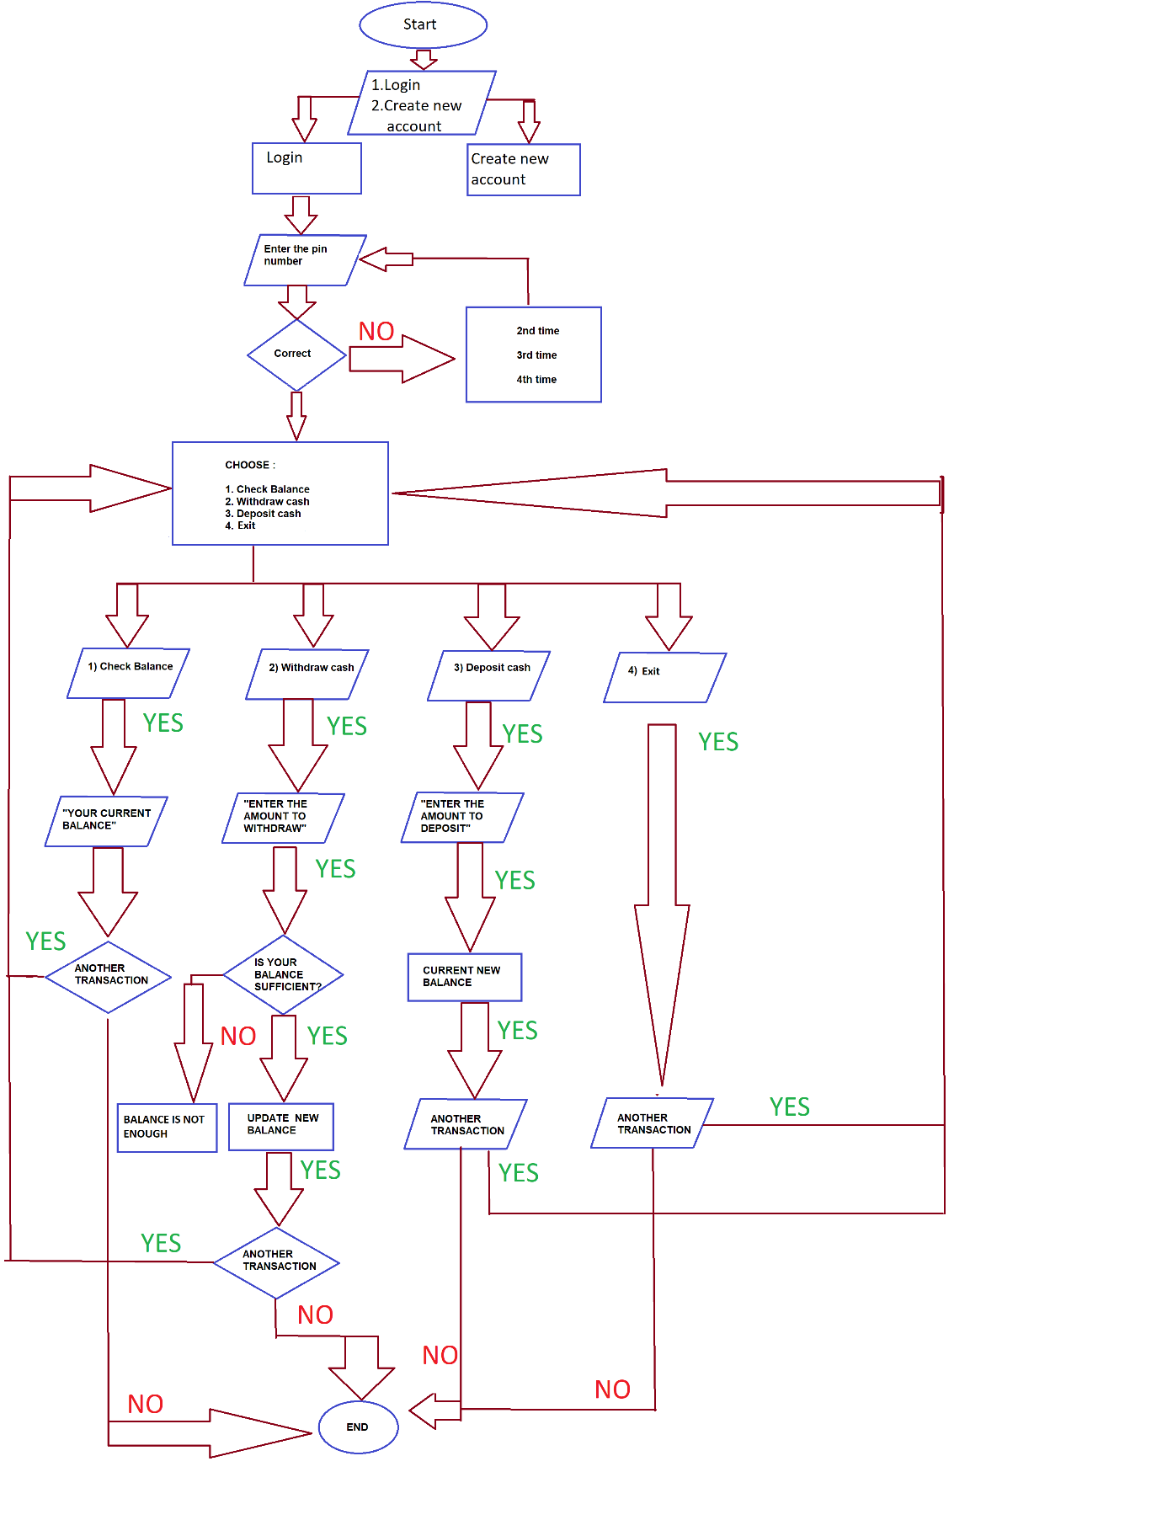
DESIGN

Slide 8
IMPLEMENTATION
void loginMenu();
void signupMenu();
struct User getUserDetails(int);
void checkBalance(struct User);
void moneyWithdraw(struct User, float);
void moneyDeposit(struct User, float);
void updateUserDetails(struct User);
int noUser = 0;

Slide 9
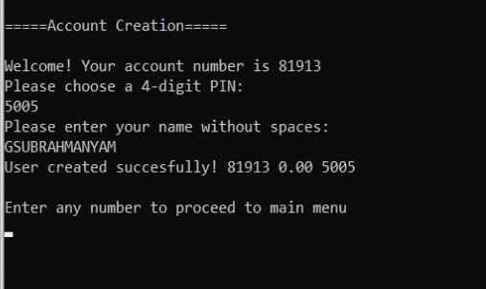
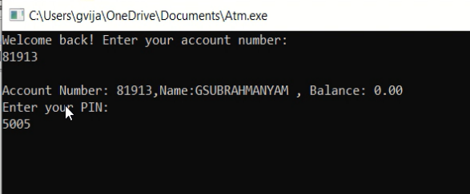
IMPLEMENTATION
1.Create an bank account for your self
2.Login into your account

Slide 10
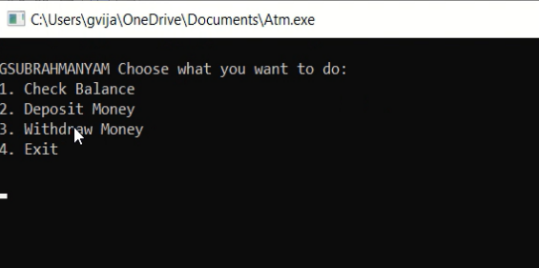
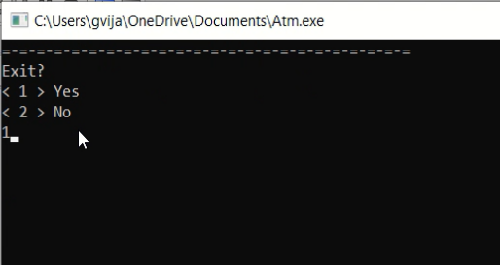
IMPLEMENTATION
3. Choose what transaction to be done
4.Exit the code

Slide 11
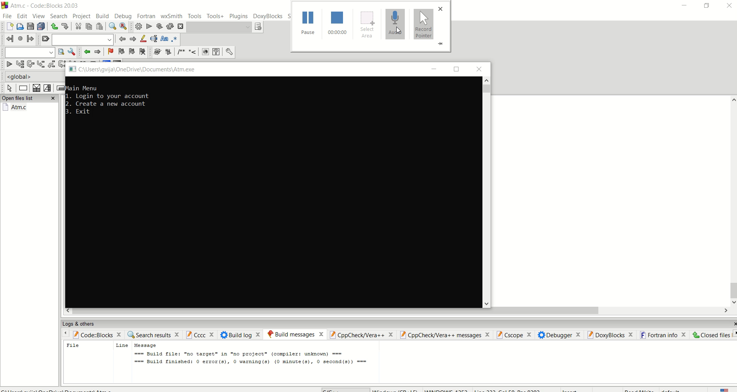
RESULTS AND DISCUSSION

Slide 12
SUMMARY
* ATM machine is an amazing machine helping people to save their time and efort. The project is done completely, if any improvements can be done we can update the code accordingly.
*If any bugs are found in the future then I will debug the accordingly. This project has helped me a lot in learning c language especially with the files management concept which has many applications.

Slide 13
FUTURE SCOPE
I want to make changes to this program ,changes like
*Amount tranfer from one account to another account.
*Generation of OTP(One Time Password) to the person’s mobile number

Slide 14
REFERENCES
[1]Documentation of C language:
https://devdocs.io/c/
[2]Tutorial for basic atm machine code:
https://www.youtube.com/watch?v=wuAzSLIJnTw
[3]For login page :
https://stackoverflow.com/questions/29732161/c-login-using-file-handling-and-linked-list

Slide 15
THANK YOU

